Slide 1
Process Synchronization

Slide 2
Chapter 5: Process Synchronization
Background
The Critical-Section Problem
Peterson’s Solution
Synchronization Hardware
Mutex Locks
Semaphores
Classic Problems of Synchronization
Monitors

Slide 3
Objectives
To present the concept of process synchronization.
To introduce the critical-section problem, whose solutions can be used to ensure the consistency of shared data
To present both software and hardware solutions of the critical-section problem
To examine several classical process-synchronization problems
To explore several tools that are used to solve process synchronization problems

Slide 4
cooperating process
A cooperating process is one that can affect or be affected by other processes
executing in the system.
Cooperating processes can either directly share a logical address space (that is, both code and data) or be allowed to share data only through files or messages.
Concurrent access to shared data may result in data inconsistency, however.
In this chapter, we discuss various mechanisms to ensure the orderly execution of cooperating processes that share a logical address space, so that data consistency is maintained

Slide 5
Background
Processes can execute concurrently
  May be interrupted at any time, partially completing execution
Concurrent access to shared data may result in data inconsistency
Maintaining data consistency requires mechanisms to ensure the orderly execution of cooperating processes
Illustration of the problem:
Suppose that we wanted to provide a solution to the consumer-producer problem that fills all the buffers. We can do so by having an integer counter that keeps track of the number of full buffers. Initially, counter is set to 0.
It is incremented by the producer after it produces a new buffer and is decremented by the consumer after it consumes a buffer.

Slide 6
Producer
while (true) {
/* produce an item in next produced */
while (counter == BUFFER_SIZE) ;
/* do nothing */
buffer[in] = next_produced;
in = (in + 1) % BUFFER_SIZE;
counter++;
}

Slide 7
Consumer
while (true) {
while (counter == 0)
; /* do nothing */
next_consumed = buffer[out];
out = (out + 1) % BUFFER_SIZE;
counter--;
/* consume the item in next consumed */
}

Slide 8
Race Condition
counter++ could be implemented as
register1 = counter
register1 = register1 + 1
counter = register1
counter-- could be implemented as
register2 = counter
register2 = register2 - 1
counter = register2
Consider this execution interleaving with “count = 5” initially:
  S0: producer execute register1 = counter {register1 = 5}
  S1: producer execute register1 = register1 + 1 {register1 = 6}
  S2: consumer execute register2 = counter {register2 = 5}
  S3: consumer execute register2 = register2 – 1 {register2 = 4}
  S4: producer execute counter = register1 {counter = 6 }
  S5: consumer execute counter = register2 {counter = 4}

Slide 9
Critical Section Problem
Consider system of n processes {p₀, p₁, … p_{n-1}}
Each process has critical section segment of code
  Process may be changing common variables, updating table, writing file, etc
  When one process in critical section, no other may be in its critical section
Critical section problem is to design protocol to solve this
Each process must ask permission to enter critical section in entry section, may follow critical section with exit section, then remainder section

Slide 10
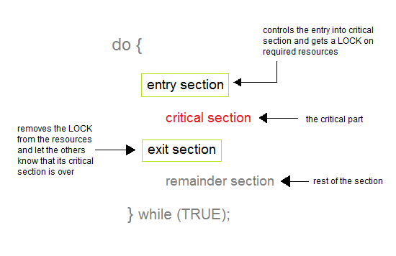
Critical Section
General structure of process P_{i}

Slide 11
Algorithm for Process P_{i}
do {
while (turn == j);
critical section
turn = j;
remainder section
} while (true);

Slide 12
Solution to Critical-Section Problem
A solution to the critical section problem must satisfy the following three conditions:
1. Mutual Exclusion
Out of a group of cooperating processes, only one process can be in its critical section at a given point of time.
2. Progress
If no process is in its critical section, and if one or more threads want to execute their critical section then any one of these threads must be allowed to get into its critical section.
3. Bounded Waiting
After a process makes a request for getting into its critical section, there is a limit for how many other processes can get into their critical section, before this process's request is granted.
So after the limit is reached, system must grant the process permission to get into its critical section.

Slide 13
Critical-Section Handling in OS
Two approaches depending on if kernel is preemptive or non- preemptive
  Preemptive – allows preemption of process when running in kernel mode
  Non-preemptive – runs until exits kernel mode, blocks, or voluntarily yields CPU
    Essentially free of race conditions in kernel mode

Slide 14
Peterson’s Solution
Good algorithmic description of solving the problem
Two process solution
The two processes share two variables:
  int turn;
  Boolean flag[2]
The variable turn indicates whose turn it is to enter the critical section
The flag array is used to indicate if a process is ready to enter the critical section. flag[i] = true implies that process P_{i} is ready!

Slide 15
Algorithm for Process P_{i}
do {
flag[i] = true;
turn = j;
while (flag[j] && turn = = j);
critical section
flag[i] = false;
remainder section
} while (true);

Slide 16
Peterson’s Solution preserves all three conditions :
Mutual Exclusion is assured as only one process can access the critical section at any time.
Progress is also assured, as a process outside the critical section does not blocks other processes from entering the critical section.
Bounded Waiting is preserved as every process gets a fair chance.
Disadvantages of Peterson’s Solution
It involves Busy waiting
It is limited to 2 processes.

Slide 17
Synchronization Hardware
Many systems provide hardware support for implementing the critical section code.
All solutions below based on idea of locking
  Protecting critical regions via locks
Uniprocessors – could disable interrupts
  Currently running code would execute without preemption
  Generally too inefficient on multiprocessor systems
    Operating systems using this not broadly scalable
Modern machines provide special atomic hardware instructions
    Atomic = non-interruptible
  Either test memory word and set value
  Or swap contents of two memory words

Slide 18
Synchronization Hardware
The critical-section problem could be solved simply in a single-processor environment if we could prevent interrupts from occurring while a shared variable was being modified.
In this way, we could be sure that the current sequence of instructions would be allowed to execute in order without preemption.
No other instructions would be run, so no unexpected modifications could be made to the shared variable. This is often the approach taken by nonpreemptive kernels.

Slide 19
Unfortunately, this solution is not as feasible in a multiprocessor environment.
Disabling interrupts on a multiprocessor can be time consuming, since the message is passed to all the processors.
This message passing delays entry into each critical section, and system efficiency decreases.
Many modern computer systems therefore provide special hardware instructions that allow us either to test and modify the content of a word or to swap the contents of two words atomically—that is, as one uninterruptible unit.
We can use these special instructions to solve the critical-section problem in a relatively simple manner.
Rather than discussing one specific instruction for one specific machine, we abstract the main concepts behind these types of instructions by describing the test and set() and compare and swap() instructions.

Slide 20
Solution to Critical-section Problem Using Locks
do {
acquire lock
critical section
release lock
remainder section
} while (TRUE);

Slide 21
The test and set() instruction can be defined as shown in
The important characteristic of this instruction is that it is executed atomically.
Thus, if two test and set() instructions are executed simultaneously (eachon a different CPU), they will be executed sequentially in some arbitrary order.
If the machine supports the test and set() instruction, thenwe can implement mutual exclusion by declaring a boolean variable

Slide 22
The test and set instruction, when used with boolean values, uses logic like that shown in the following function, except that the function must execute atomically. That is, no other process must be able to interrupt the function mid-execution, thereby seeing a state that only exists while the function executes

Slide 23
Solution using test_and_set()
Shared Boolean variable lock, initialized to FALSE
Solution:
do {
while (test_and_set(&lock))
; /* do nothing */
/* critical section */
lock = false;
/* remainder section */
} while (true);

Slide 24
compare_and_swap Instruction
Definition:
int compare _and_swap(int *value, int expected, int new_value) {
int temp = *value;
if (*value == expected)
*value = new_value;
return temp;
}
Executed atomically
Returns the original value of passed parameter “value”
Set the variable “value” the value of the passed parameter “new_value” but only if “value” ==“expected”. That is, the swap takes place only under this condition.

Slide 25
Solution using compare_and_swap
Shared integer “lock” initialized to 0;
Solution:
do {
while (compare_and_swap(&lock, 0, 1) != 0)
; /* do nothing */
/* critical section */
lock = 0;
/* remainder section */
} while (true);

Slide 26
Bounded-waiting Mutual Exclusion with test_and_set
do {
waiting[i] = true;
key = true;
while (waiting[i] && key)
key = test_and_set(&lock);
waiting[i] = false;
/* critical section */
j = (i + 1) % n;
while ((j != i) && !waiting[j])
j = (j + 1) % n;
if (j == i)
lock = false;
else
waiting[j] = false;
/* remainder section */
} while (true);

Slide 27
Mutex Locks
Previous solutions are complicated and generally inaccessible to application programmers
OS designers build software tools to solve critical section problem
Simplest is mutex lock
Protect a critical section by first acquire() a lock then release() the lock
  Boolean variable indicating if lock is available or not
Calls to acquire() and release() must be atomic
  Usually implemented via hardware atomic instructions
But this solution requires busy waiting
  This lock therefore called a spinlock

Slide 28
Mutex
The operating-systems designers build software tools to solve the critical-section problem. The simplest of these tools is the mutex lock. (In fact, the term mutex is short for mutual exclusion.)
We use the mutex lock to protect critical regions and thus prevent race conditions.
That is, a process must acquire the lock before entering a critical section; it releases the lock when it exits the critical section.
The acquire()function acquires the lock, and the release() function releases the lock.
A mutex lock has a boolean variable available whose value indicates if the lock is available or not.
If the lock is available, a call to acquire() succeeds, and the lock is then considered unavailable.
A process that attempts to acquire an unavailable lock is blocked until the lock is released.

Slide 29
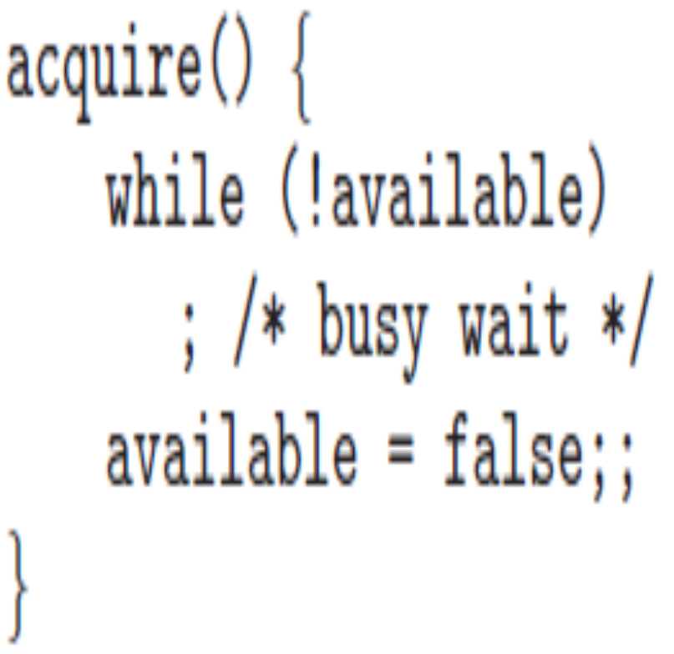
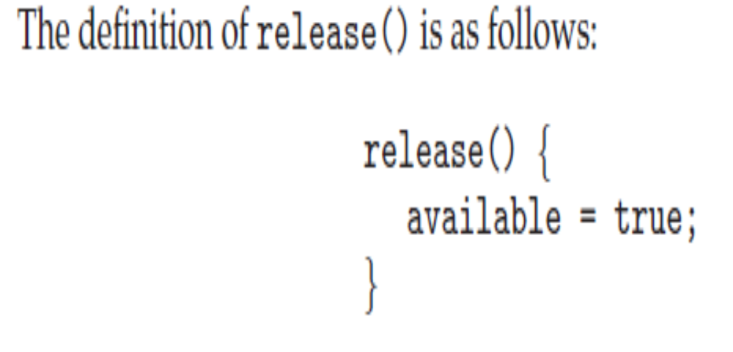
A mutex lock has a boolean variable available whose value indicates if the lock is available or not.
If the lock is available, a call to acquire() succeeds, and the lock is then considered unavailable.
A process that attempts to acquire an unavailable lock is blocked until the lock is released.
The definition of acquire() and release() is as follows:

Slide 30
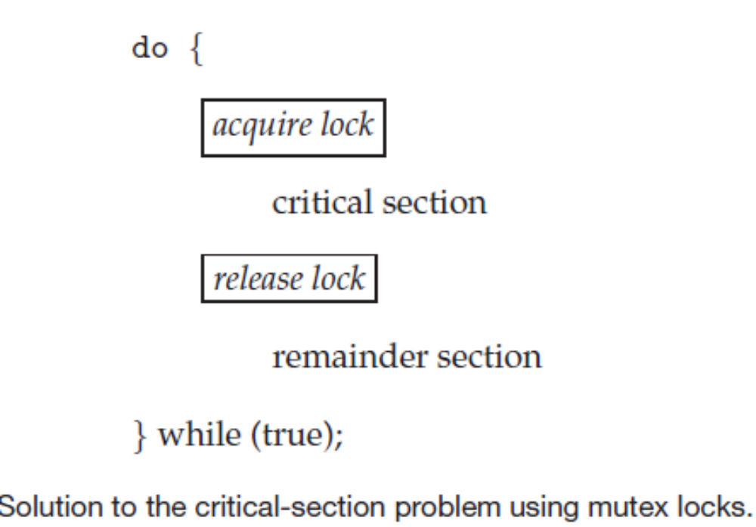

Slide 31

Monitor with Condition Variables

Slide 32

Schematic view of a Monitor

